Slide 1
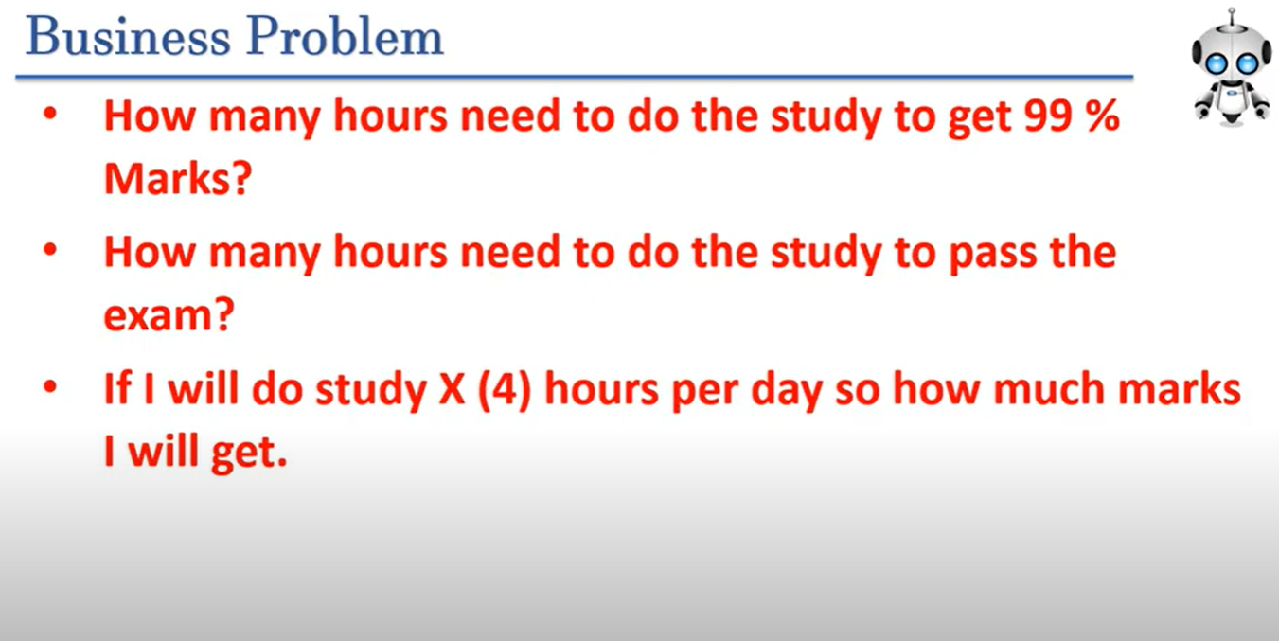
Machine Learning model End to End Deployment using Flask & HTML

Slide 2

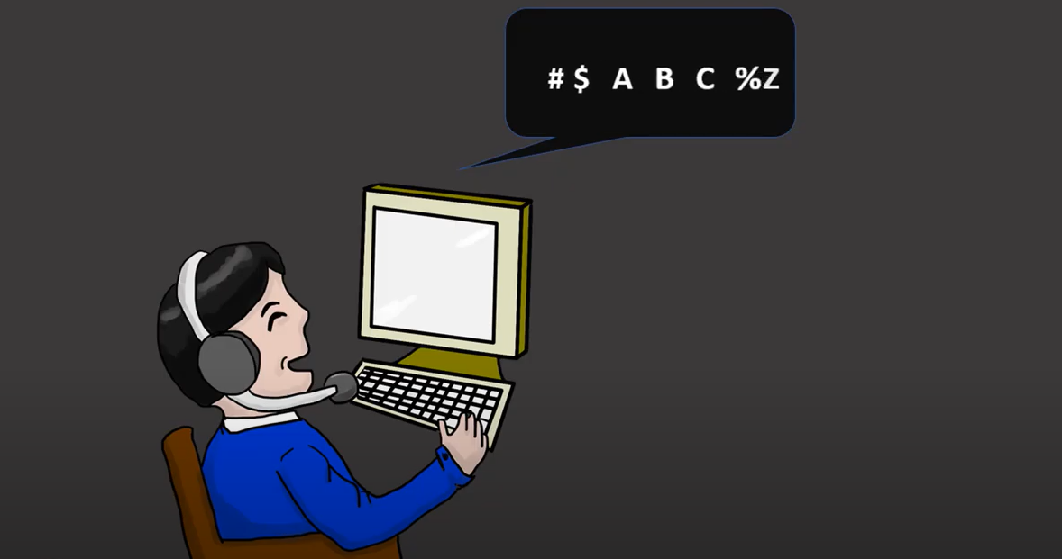
Business use case discussion happened between oxtandhard university & AMX Software pvt ltd
AMX SOFTWARE
PVT LTD

Slide 3
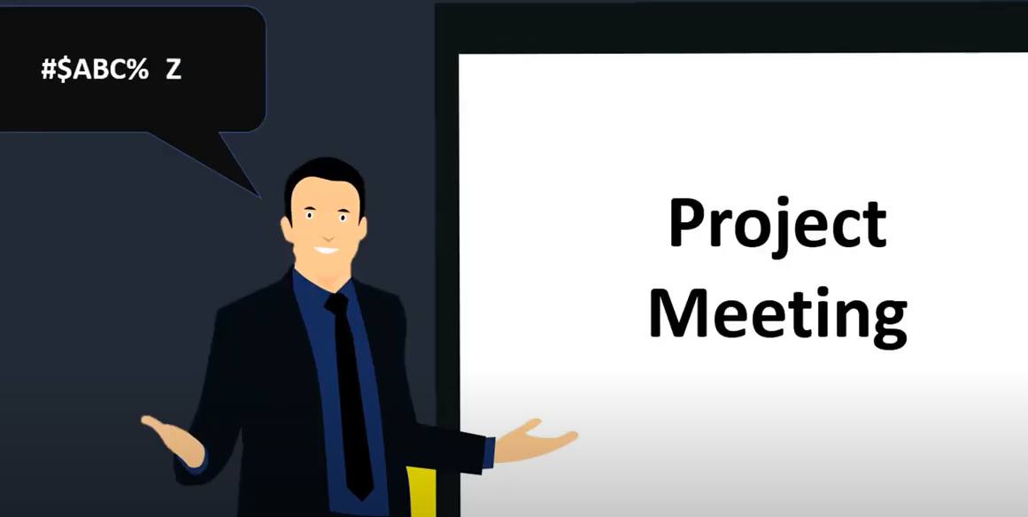
Problem statement -
students are working day and night but unable to to get good scores & till now no student is achieved >90%
Organization need to suggest to university how many hours student need to study to get more then 60% score because in our university minimum score should be >= 60% to pass
University want to know if our student study for 3hr, 4hr or 5hr then how much probability score student can get & our university should become top of the world
If we came to know how many hour if student can study then it is good for our university to explain students to achieved his goal

Slide 4
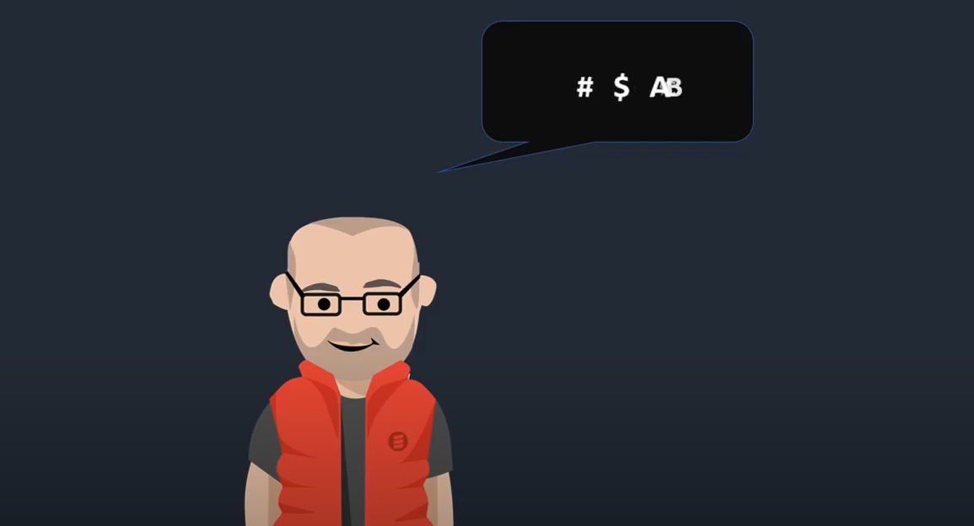
AMX Software pvt Ltd-
AMX ceo said to solve this problem statement need to discuss with the project team & also need to understand what is the technical requirement to solve this problem
CEO discussed with project team explaining we got new client called o.x. university & and their requirement is to predict how many need to spend on study to get the percentage
How to solve this problem and can we build some end to end application
One team explained we can create using android application or developed a website is the solution for this problem. CEO said then we have to write if else condition and all company is doing this.
to solve this problem we required Artificial Intelligence system
CEO had discussion with datascince team one employee explained to required students history data from the university
To know the prediction we need to students data we need to know last exams average per day how many hours student has spend for studying
Finally the agreement will sign between university and organization

Slide 5
